Slide 1
More on Filters
Parametric Equalizers

Slide 2
Parametric Equalizer
Consists of several filters connected in series – multiple “bands”
Typical bands:
  High and Low Pass (sometimes fixed Hz)
  Two or more Band Pass (adjustable Hz)
Typical parameters:
  Amount of boost or cut in dB
  CF and Q (for Band Pass filters)
  “Rolloff Characteristic” (for high and low bands)
    Either High/Low Pass, or “Shelving”

Slide 3
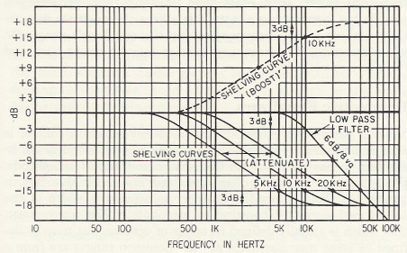
Typical High Frequency Curves
Note: the “turnover” frequency in a shelving filter’s response is sometimes called the “knee” or “corner”

Slide 4
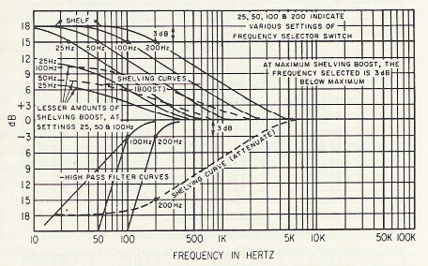
Typical Low Frequency Curves

Slide 5
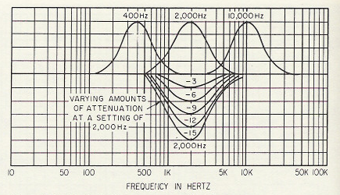
Typical Mid Frequency Curves
Multiple BP Filters – “Peaking” Equalization

Slide 6
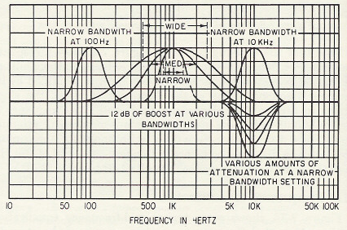
Typical Mid Frequency BWs
Band widths usually controlled by a Q control
Higher Q’s imply narrower band widths

Slide 7
The Csound pareq Opcode
ar pareq asig, kc, kv, kq [, imode]
Where:
kc = CF in peaking mode; “corner” in shelving
kv = amount of boost or cut (use ampdb)
kq = kq -- Q of the filter (sqrt(.5) is no resonance)
imode = 0 (default) for peaking filter (bandpass)
1 for low shelving
2 for high shelving

Slide 8
Example Instrument
instr 15
ifc = p4 ; Center / Shelf
kq = p5 ; Quality factor
kv = ampdb(p6) ; Volume Boost/Cut
imode = p7 ; 0, 1, or 2
kfc linseg ifc*2, p3, ifc/2
asig rand 5000 ; white noise
aout pareq asig, kfc, kv, kq, imode ; Parmetric EQ
outs aout, aout
endin

Slide 9

Example Score
; Sta Dur Fcenter Q Boost/Cut(dB) Mode
i15 0 1 10000 .2 12 1
i15 + . 5000 .2 12 1
i15 . . 1000 .707 -12 2
i15 . . 5000 .1 -12 0
e

